Slide 1

“AI-Based Student Mental Health Support System”
RITHIKKA J
22AD098
RAJAPREETHI V
22AD095
MENTOR : Ms.HEMALATHA.D
Dept of AI & DS
Chennai Institute of Technology, Chennai - 69

Slide 2
INTRODUCTION
Mental health issues such as stress, anxiety, and depression are increasingly common among students due to academic pressure, lifestyle changes, and social challenges.
Many students hesitate to seek professional help because of stigma, lack of awareness, or limited access to mental health resources.
With the advancement of artificial intelligence and machine learning, technology can play an important role in providing early mental health support.
The proposed AI-Based Student Mental Health Support System aims to help students monitor their mental well-being through self-assessment questionnaires, machine learning prediction, and an AI chatbot.
The system analyzes user responses to predict mental health risk levels and provides supportive guidance and wellness activities to promote emotional well-being.

Slide 3
PROBLEM STATEMENT
Many students struggle to recognize their mental health issues accurately, leading to delayed help-seeking or worsening stress.
Traditional counselling and mental health apps are often generic, culturally unsuitable, or difficult to access, which prevents students from getting timely support.
Counsellors face increasing workload, making it hard to provide immediate guidance for mild or early-stage mental health concerns.
There is a need for an automated, intelligent, and user-friendly system that can analyze student self-assessment data and provide quick, reliable mental health guidance.
The challenge lies in effectively interpreting text inputs from students using NLP and accurately predicting stress, anxiety, or depression levels using Machine Learning models.problem statement

Slide 4

PROJECT OBJECTIVES
The primary objective of this project is to design and develop a web-based system for assessing students’ mental health conditions using Machine Learning and Artificial Intelligence techniques.
The system aims to collect self-assessment data securely and analyze it using a Logistic Regression model to accurately identify stress, anxiety, and depression levels.
Another objective is to integrate an AI chatbot based on Natural Language Processing to enable interactive communication and provide basic guidance to students.
The project also focuses on ensuring user privacy and anonymity to encourage honest participation.
Additionally, the system seeks to support early detection of mental health issues, reduce the manual workload of counselors through automated screening, and provide a scalable solution that can be enhanced with advanced models and features in the future.

Slide 5
LITERATURE REVIEW
Researchers have used machine learning algorithms such as logistic regression and decision trees to predict mental health conditions like stress and depression from questionnaire data.
Natural Language Processing (NLP) techniques are used to analyze user text and detect emotions through sentiment analysis.
AI chatbots are widely used in mental health applications to provide basic emotional support and guidance through conversations.
Many systems include self-assessment questionnaires and wellness activities to help users monitor and improve their mental well-being.
Limitations: Generic advice, no personalization, reactive, and limited emotion understanding.

Slide 6
METHODOLGY
Data Collection: Users provide input by answering mental health self-assessment questionnaires and interacting with the chatbot through the web interface.
Data Preprocessing: The collected questionnaire data is cleaned, organized, and converted into a suitable format for machine learning analysis.
Machine Learning Model: A Logistic Regression model is used to analyze the processed data and predict the user’s mental health risk level (low, moderate, or high).
Chatbot Processing: User messages are analyzed using Natural Language Processing (NLP) techniques to detect emotions and provide supportive responses.
Result Generation: The system generates prediction results and personalized feedback based on the analysis.
Data Storage: All user data, predictions, and chatbot conversations are securely stored in a database for future reference and monitoring.

Slide 7
IMPLEMENTATION
Frontend Development: The user interface was developed using HTML, CSS, and JavaScript to provide an interactive platform where users can complete questionnaires, interact with the chatbot, and view results.
Backend Development: The backend was implemented using the Django framework in Python to handle user requests, process data, and manage communication between different modules.
Machine Learning Integration: A Logistic Regression model was integrated into the backend to analyze questionnaire responses and predict the mental health risk level of users.
Chatbot Integration: A rule-based and NLP-supported chatbot was implemented to analyze user messages and provide supportive responses based on detected emotions.
Database Management: A database was used to store user information, questionnaire responses, prediction results, and chatbot conversation history securely.
API Communication: HTTP and API requests were used to enable smooth data exchange between the frontend interface and backend processing modules.

Slide 8
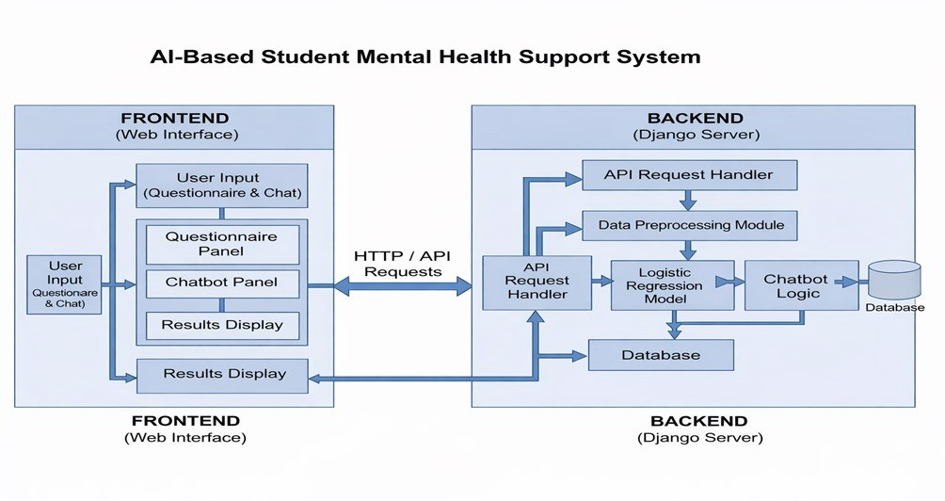
ARCHITECTURE DIAGRAM

Slide 9
RESULTs & ANALYSIS
The system was tested using sample questionnaire responses and chatbot interactions.
The Logistic Regression model successfully predicted mental health risk levels such as low, moderate, and high.
The chatbot analyzed user messages and provided supportive responses.
In addition, the system includes relaxation exercises and simple games to help reduce stress and improve user engagement.
These activities encourage users to take short mental breaks and maintain emotional balance.
The results are displayed on the user dashboard, allowing users to view their mental health status, activity progress, and personalized feedback
The results are displayed on the dashboard, allowing users to view their mental health status and feedback.

Slide 10
CONCLUSION
The AI-based mental health support system helps users monitor their mental well-being through questionnaires, machine learning prediction, and chatbot interaction.
The system analyzes user responses and predicts mental health risk levels such as low, moderate, or high.
The chatbot provides supportive responses and basic coping suggestions based on user messages.
In addition, the platform includes relaxation exercises and simple games that help reduce stress and improve user engagement.
The system also stores user data securely and displays results through a dashboard for easy understanding.
Overall, the project demonstrates how artificial intelligence, machine learning, and web technologies can be integrated to create an accessible and effective mental health support platform for users.

Slide 11
FUTURE SCOPE
A mobile application version can be developed so users can access mental health support anytime and anywhere.
The chatbot can be improved using advanced NLP and conversational AI to provide more personalized and human-like responses.
The system can be integrated with wearable devices or health tracking apps to monitor stress levels, sleep patterns, and physical activity.
The system can be enhanced by using advanced machine learning and deep learning models to improve the accuracy of mental health prediction.
Additional wellness activities, games, and meditation programs can be added to improve user engagement and mental relaxation.

Slide 12

RITHIKKA J
rithikkaj.aids2022@citchennai.net
RAJAPREETHI V
rajapreethi.aids2022@citchennai.net

